Slide 1
Getting started in Codespace
A guide for students

Slide 2
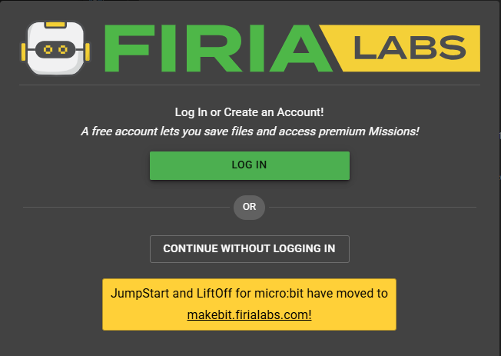
Open CodeSpace:
Open the Chrome browser
Use the link, or type the URL directly into the browser: https://make.firialabs.com/

Slide 3
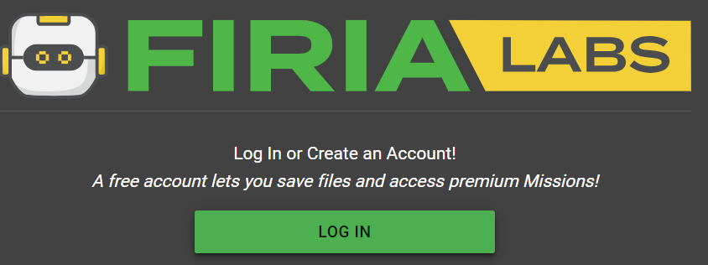
Log in:

Slide 4
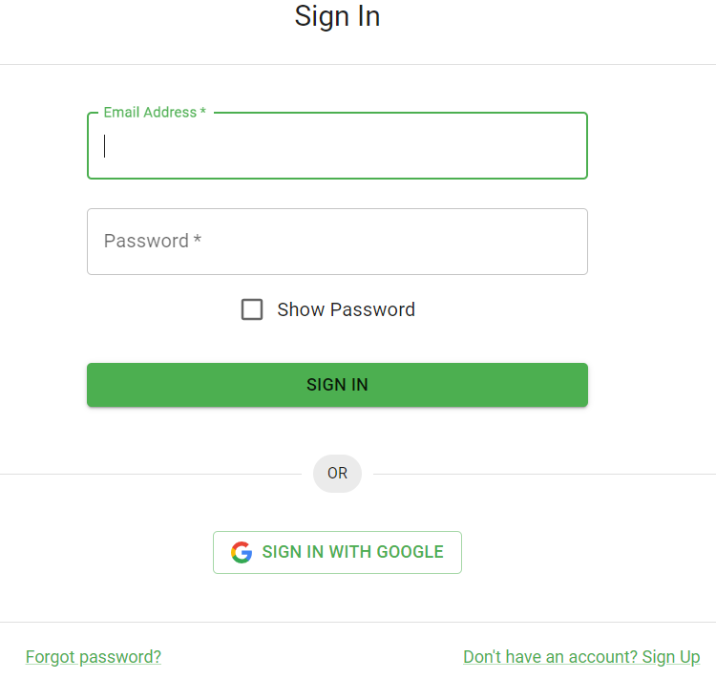
Sign in:
You can:
Sign in with Google and select your gmail
–or–
Create an account using your email address

Slide 5

CodeSpace
On the bottom left of the editor are two icons
Setting preferences
Log in / log out

Slide 6

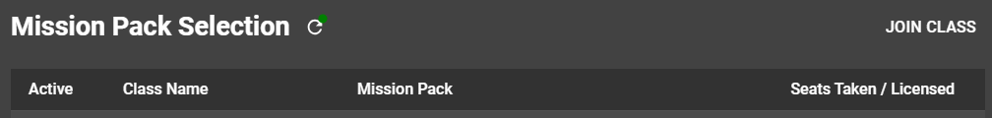
Join your class
On the top left of the editor is the class icon
Click on the icon
The click “JOIN CLASS”
Enter the code from
your teacher

Slide 7
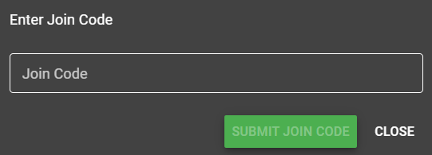
Join your class
Enter the code from your teacher
Then “SUBMIT JOIN CODE”

Slide 8

All set!
Your class should now be activated.
You should see these icons in the upper right hand corner of the window:
You are ready to begin!

Slide 9
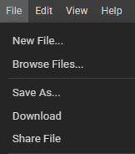
Notes:
Your programming files are saved automatically, all the time, just like a Google drive
If you want to make changes to a program, but keep the original, “Save As…” with a new name first!
You can open previously saved files by going to “Browse Files…”
You can download a text file of your code with “Download”
You can get a link of your project to share with your teacher with “Share File”

